Slide 1
Hexagonal Architecture
Marcus Biel Software Craftsman www.marcus-biel.com

Slide 2

Maintainability

Slide 3
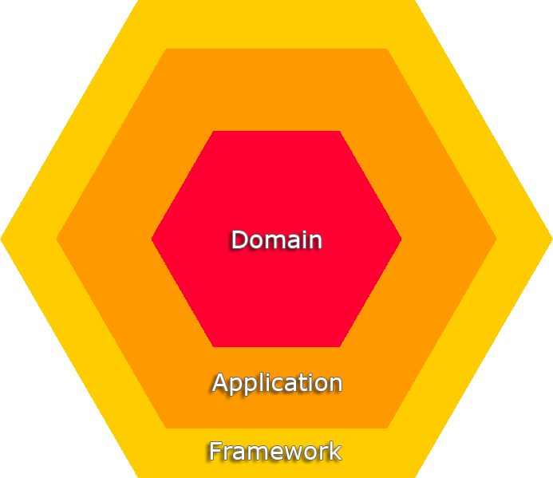
The Hexagon

Slide 4

The Outside

Slide 5


Slide 6
Framework
public class HttpController extends BaseController {
[...]
public void process(Request req, Response resp) {
[...]
comandBus.execute(new Command(param1…));
}
[...]
}

Slide 7
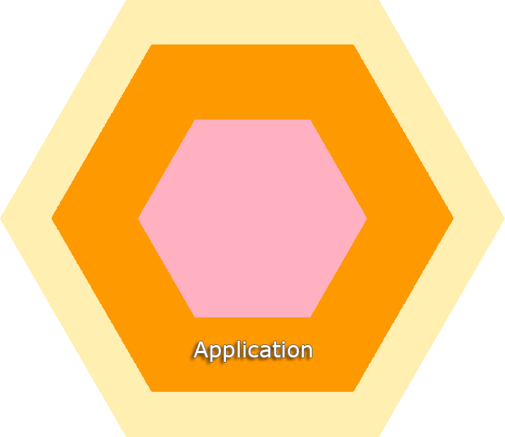

Slide 8
Application
public class CB implements CommandBus {
[…]
public void execute(Command command) {
registry.getHandler(command).execute();
}
[…]
}

Slide 9
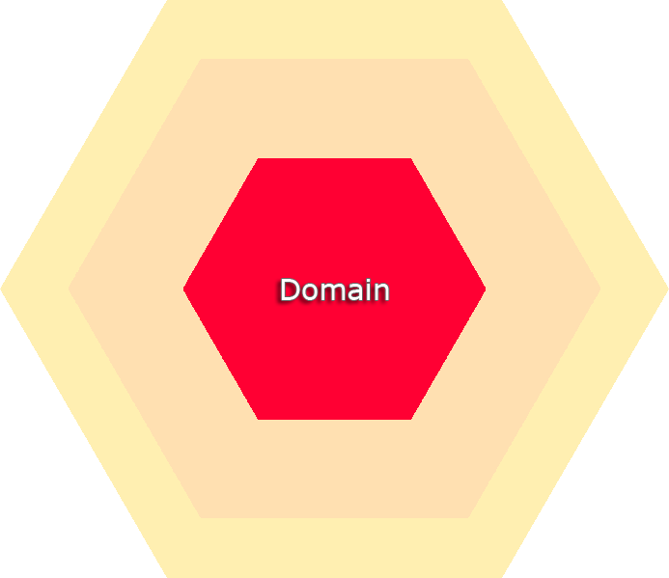

Slide 10
Domain
public class Car implements Domain {
public void drive(Gear gear) {
if(isNotAllAllowed(gear){
throw new InvalidGearException();
}
}
}

Slide 11

Ports

Slide 12

Ports & Adapters

Slide 13
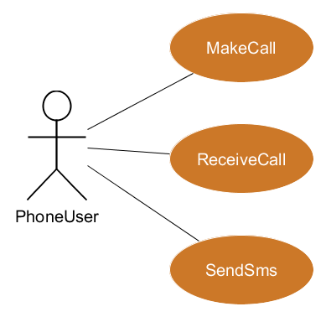
Use Case

Slide 14
The Hexagon

Slide 15
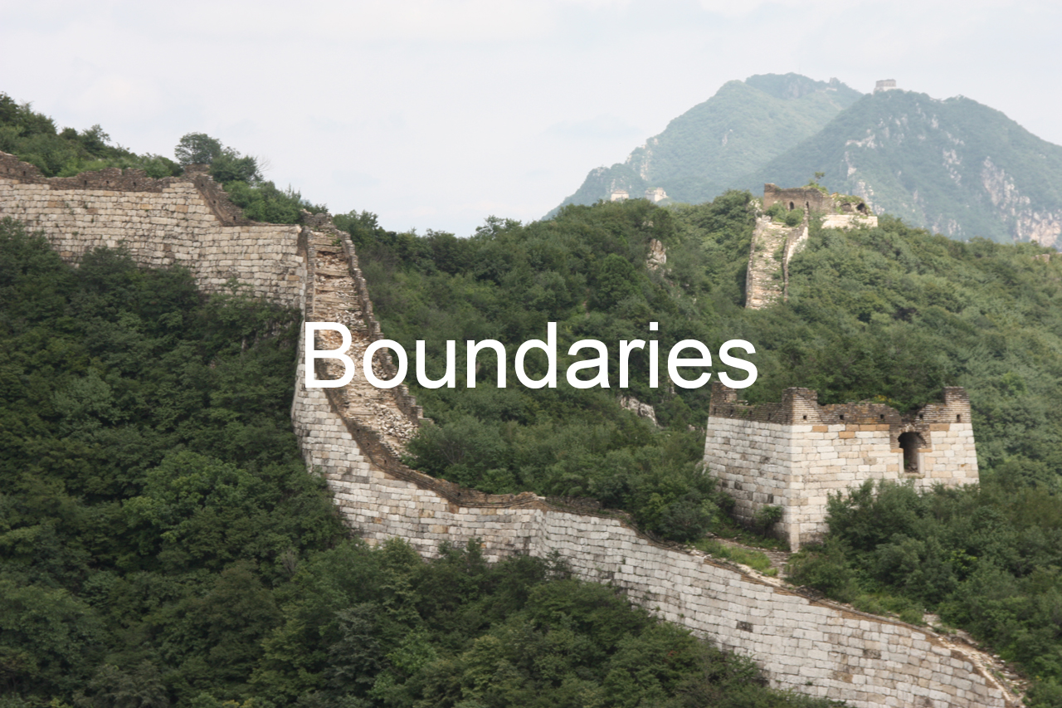

Slide 16
public interface CommandBus {
void execute(Command command);
}

Slide 17
public interface CommandHandler {
public void handle(Command command);
}

Slide 18
A good architecture
maximizes the
number of decisions
NOT made
Robert C. Martin

Slide 19
A good architecture
allows major decisions to be deferred
Robert C. Martin

Slide 20
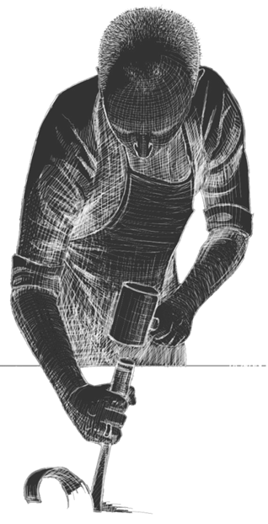
Questions?
@MarcusBiel www.marcus-biel.com

Slide 21
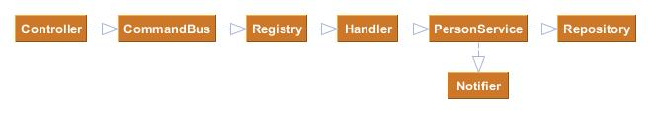
Birthday-Greeting-Kata

Slide 22
References
Chris Fidao, Hexagonal Architecture
http://fideloper.com/hexagonal-architecture
Robert C Martin - Clean Architecture and Design
https://www.youtube.com/watch?v=Nsjsiz2A9mg
Birthday-Greeting-Kata:
http://matteo.vaccari.name/blog/archives/154

